Slide 1
Presentation 01
“Modeling Environment”
Sep 06, 2022

Slide 2
Expectations
Scalable
Fathomable
Fast

Slide 3
How I Approach
Environment
Agent(s)
more on that later…

Slide 4
Environment: “Entity”
class Entity:
- can produce, use, and store certain resources
- has a physical “location”

Slide 5
Environment: “Resource”
class Resource:
- represents a certain resource
- gets added to the entity
- has a number of “links” to other entities

Slide 6
Environment: “Link”
class Link:
- represents a link between two entities for a certain resource
- gets added to resource instances
- has “chance” of working for the route
- has “price_factor” indicating the hardness of transfer
- can be “active” or not
- has “max_discharge” indicating maximum volume per step

Slide 7
Environment: “Model”
“Model” is the model of environment
class Model:
- main class for representing environment
- entities are added to this class
- economy is in charge of updating values in the model
- can convert data within the model into JSON
- can load data within the model from JSON
- at each step, a broken link between entities may occur

Slide 8
Environment: Example
entity_1 = Entity(
name='city_1',
location=[0.7, -0.5],
resources=[resource_1]
)
entity_2 = Entity(
name='city_2',
location=[-0.3, 0.4],
resources=[resource_2]
)
resource_1 = Resource(
name='water',
source=5,
demand=4,
deficiency_current=0,
deficiency_max=10,
storage_current=2,
storage_max=10,
connections=[
Link(
end='city_2',
active=True,
chance=1,
price_factor=1,
max_discharge=3
),
]
)
resource_2 = Resource(
name='water',
source=7,
demand=4,
deficiency_current=0,
deficiency_max=12,
storage_current=0,
storage_max=8,
connections=[
Link(
end='city_1',
active=True,
chance=1,
price_factor=1.2,
max_discharge=5
),
]
)
Model(entities=[entity_1, entity_2])

Slide 9
How Model Works: Graphs
The information within the model needs to convert into graph(s)
“networkx” library is used for handling graphs (www.networkx.org)
Two graph representations are useful:
(normal) graph
detailed graph

Slide 10
How Model Works: “(Normal) Graph”
city_1
city_2
(normal) graph is a directed multi-graph

Slide 11
How Model Works: “Detailed Graph”
Demand
Demand
Storage
Storage
Source
Source
Source
city_1
city_2
connections within the entity
connections from city_1 to city_2
connections from city_2 to city_1
detailed graph is a directed graph

Slide 12
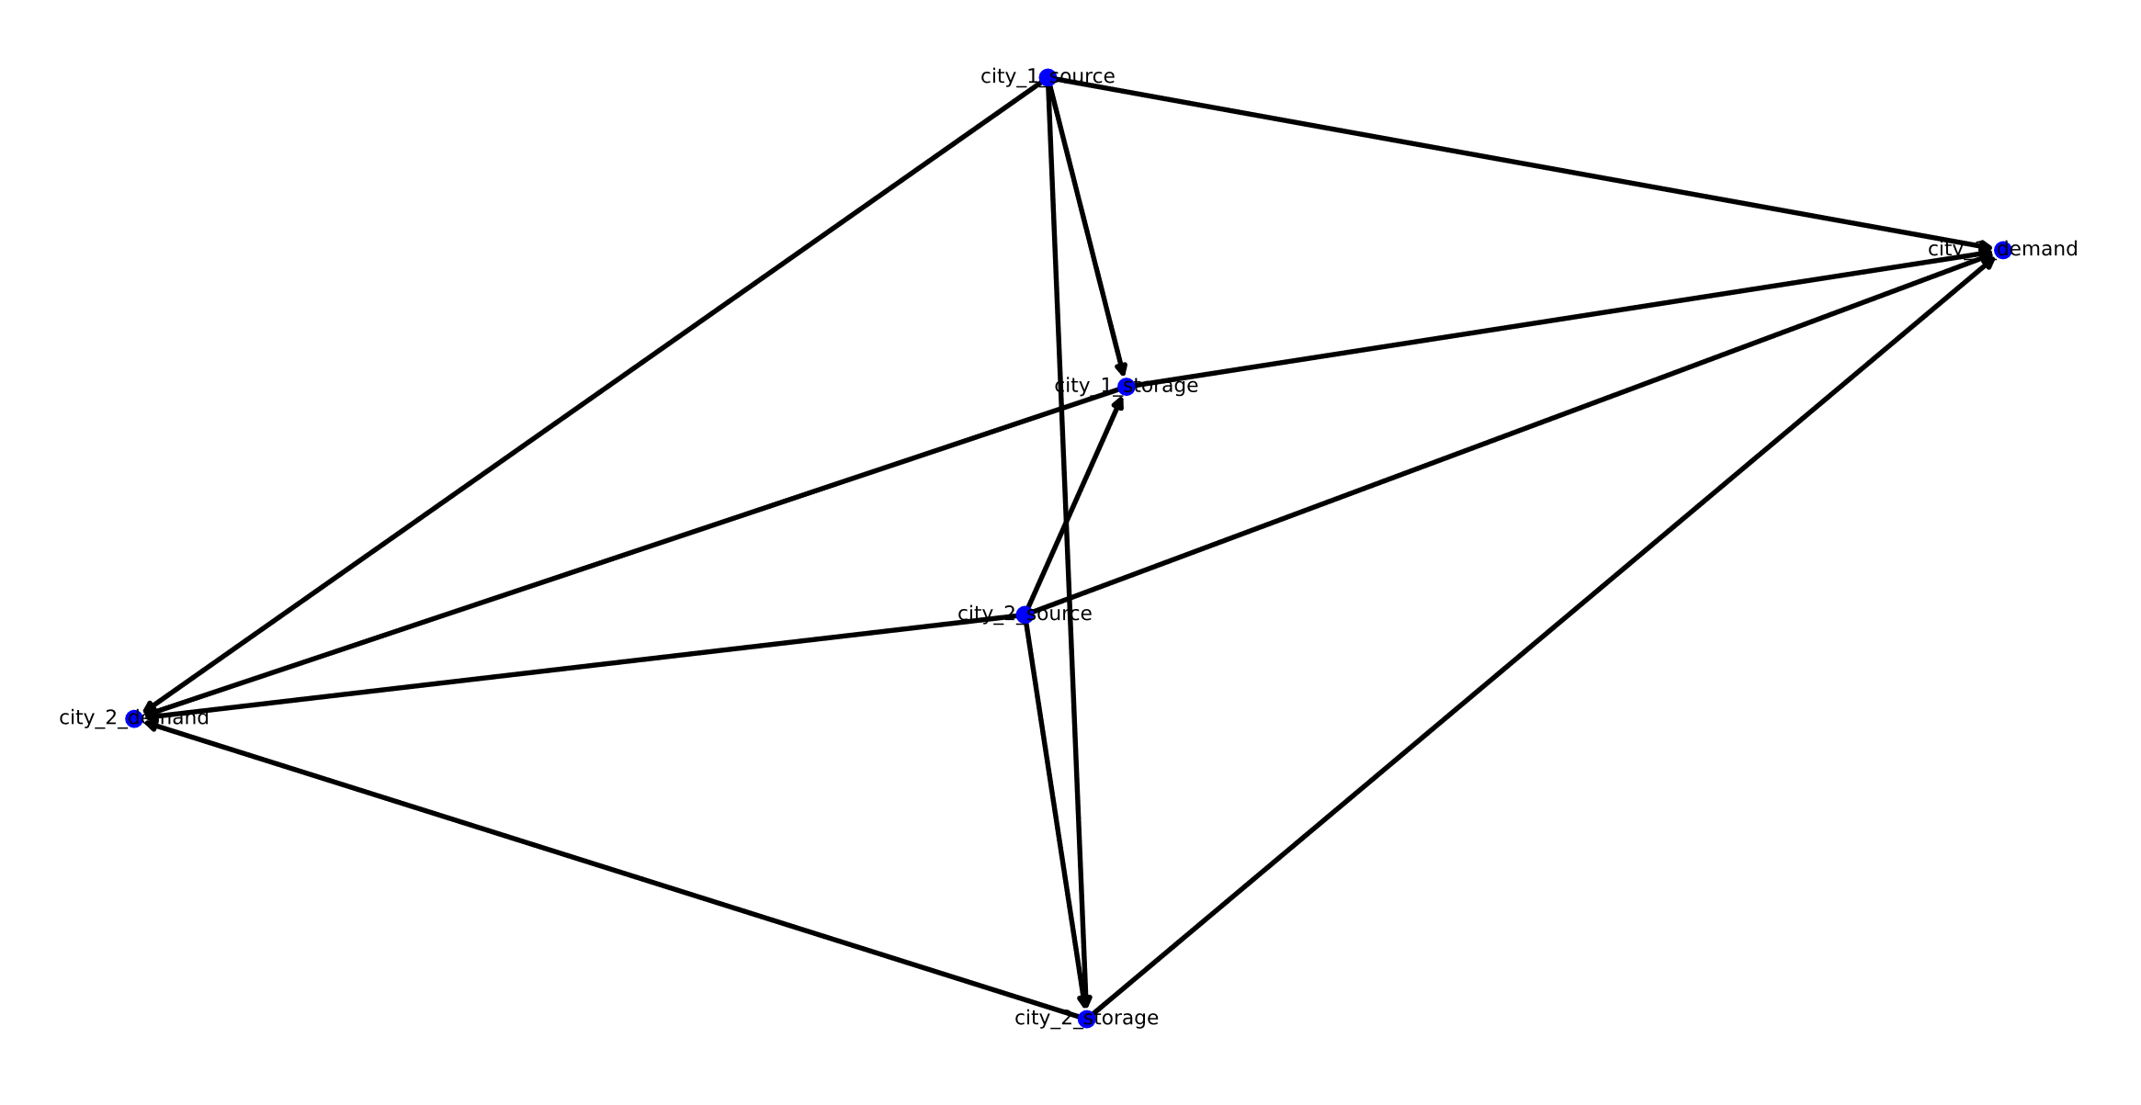
How Model Works: “Detailed Graph”
generated programmatically from example (still boring)

Slide 13
How Model Works: “Economy”
Definition: “the way resources get distributed”
class Economy:
- accepts the detailed graph of model, and runs it
- works hand in hand with model class
- decides about resource distribution

Slide 14
How Economy Works: Edge Types
There are three types of edges in the detailed graph:
Edge Type 1: from “source” to “demand”
Edge Type 2: from “storage” to “demand”
Edge Type 3: from “source” to “storage”
This type of edge was ignored all together in the model:
Edge Type 4: from “storage” to “storage”

Slide 15
How Economy Works: “Method 1”
Phase 1/2:
“It is better to use the resource than to store it.” Therefore, during this phase, the goal is calculating the result by neglecting “storage” nodes.
1. The “storage” nodes are neglected. (only edge type 1: from “source” to “demand”)
2. The edges that are not active or have inactive nodes are neglected
3. The edges starting from a “source” node with source = 0,
ending in a “demand” node with demand = 0, or
if (edge.discharge_current > edge.discharge_max)
are neglected.

Slide 16
How Economy Works: “Method 1”
Phase 1/2:
4. For each “demand” node, the best “source” is selected based on score:
score(edge) = distance(edge) * price_factor(edge)
5. The transaction is made between them and the graph information is updated
6. Back to step 3, and repeat until no transaction was possible.
7. Update graph, the unmet demands volume will be deficiency_current, and if it exceeds deficiency_max, the entity is not active anymore. The extra source volume will also go to waste.

Slide 17
How Economy Works: “Method 1”
Phase 2/2:
During this phase, the goal is adding “storage” nodes to the calculations.
1. The “storage” nodes are also involved (all edge types)
2. The edges that are not active or have inactive nodes are neglected
3. The edges starting from a “storage” node will have:
“storage”.source = “storage”.storage_current
The edges ending to a “storage” node will have:
“storage”.demand = “storage”.storage_max - “storage”.storage_current

Slide 18
How Economy Works: “Method 1”
Phase 2/2:
4. The edges starting from a “source” or “storage” node with source = 0,
ending in a “demand” or “storage” node with demand = 0, or
if (edge.discharge_current > edge.discharge_max)
are neglected.
5. For each node with a positive demand, the best “source” or “storage” node is selected based on score:
score(edge) = distance(edge) * price_factor(edge)
6. The transaction is made between them and the graph information is updated
7. Back to step 3, and repeat until no transaction was possible.

Slide 19
How Economy Works: “Method 1”
Phase 2/2:
8. Update graph, the unmet demands volume will be deficiency_current, and if it exceeds deficiency_max, the entity is not active anymore. The extra source volume will also go to waste.

Slide 20
Steps I’ve Taken for Implementation
I’ve immigrated my implementation to networkx, but the Economy class is remaining.
Simple graphics using networkx implemented.
JSON conversion/reading for model is done.

Slide 21
Steps I Will Took for Implementation
Finishing Economy class and connecting to Model class in order to run it
Enhancing graphics
Using JSON capability to implement save/load for model
Implementing the link breakage scenarios

Slide 22
Comments on My Approach: “storage”
I’ve neglected the edge type 4 (from “storage” to “storage”) altogether in the model.

Slide 23
Comments on My Approach: from scratch?
Probably, I relied too much on implementing from scratch.
Cons:
- more development effort and time
- library routines are fast and tested
- probably less understandable for other viewers
Pros:
- gaining better insight into the problem
- more aligned with my way of formulating the problem
- more flexible
- less dependencies

Slide 24
Comments on My Approach: “Transaction”
best(“source_1”):
>>> “demand_1”
The way of choosing the best fit for transaction during economic calculations seems spooky.
best(“demand_1”):
>>> “source_2”
demand_2
best(“source_2”):
>>> “demand_2”
source_2
demand_1
best(“demand_2”):
>>> “source_2”
source_1

Slide 25
Comments on My Approach: “Transaction”
Also, the node that the calculations start seems to have an effect on final result.
One possible way: shuffling nodes before calculations?

Slide 26
Comments on My Approach: “Entity”
An entity, although represents a city, can also represent an agent.
An entity, as a city, uses Economy to preform updates and to “decide” about the next step.
An entity, as an agent, uses some other form of decision making. Unlike cities, it also can chance its location.
A city, is a sum of its agents. Is there a link between Economy and decision making algorithm in agents?

Slide 27
Thank you for your patience

